Slide 1
Iteration Review #2

Slide 2
Goals of the previous iteration
Setup Back- and Frontend
Model User and Exercises
Build Test Environment (Backend)

Slide 3
Goals reached
Setup Back- and Frontend
Backend Authentication moved to Sprint 2
Model User and Exercises
Build Test Environment (Backend)

Slide 4
Learnings and current problems

Slide 5
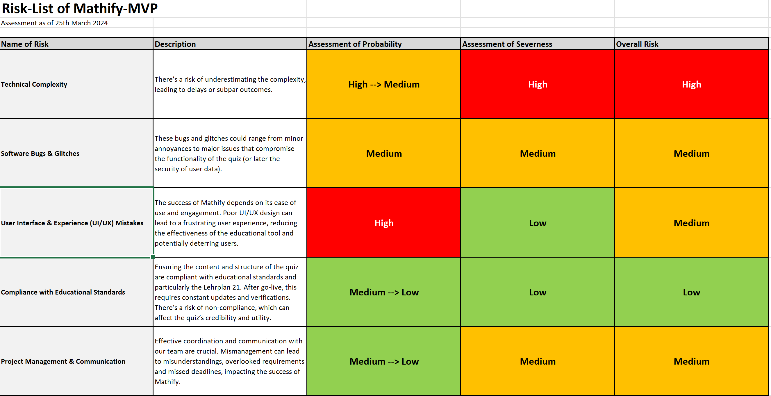
Current Risks

Slide 6
Goals for the next iteration
Backend Authentication
GUIs for user registration, grade selection and mode selection
Test frontend to backend connection
Good draft for Technical report I
Implement grade 1 exercises
Implement Scoreboard

